Slide 1
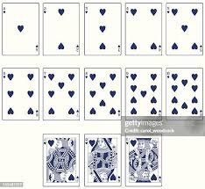
A: {a}
2: {b, c}
3: {a,b,c}
4: {d,e,f,g}
5: {a,d,e,f,g}
6: {d,e,f,g,h,i}
7: {d,e,f,g,h,i,l}
8: {d,e,f,g,h,i,l,m}
9: {a,d,e,f,g,n,o,p,r}
10: {d,e,f,g,n,o,p,r,s,t}
J: {d,g,j}
Q: {d,g,q}
K: {d,g,k}
All cards have: {u,v,w,x}
Html examples:
<div class="a">&hearts;</div>
<img class="q" src="images/queen.png">
Style for each class specfies:
Position relative to top-left of card
Size
Orientation
u
e
e
v
b
b
d
d
a
a
a
w
c
c
f
g
f
g
x
d
e
d
e
d
e
d
e
d
e
l
l
s
h
n
o
n
o
i
h
i
h
i
a
m
p
r
p
r
g
t
f
f
g
f
g
f
g
f
g
d
d
d
j
q
k
g
g
g

